Slide 1
Struts 1.3
Rajeev Gupta MTech CS
Rgupta.metch@gmail.com

Slide 2
Agenda
Why struts1
Struts 1.x Architecture , Struts components
Revisiting Hello world with validation and resource bundle
DynaActionForm
Struts ForwardAction
Multiple configuration files example
DispatchAction
Using RequestProcessor for ensure loggin user
Validation Framework

Slide 3
Why Struts1?

Slide 4
Why Struts?
Apache’s open source web application model view controller framework project
Why Struts ?
ilities of SW projects: Flexibility, Maintainability, Extensibility
Problem with our MVC servlet jsp application
A single MVC app will have many models, views, and controllers
application grows no of controller increases...problem

Slide 5
Struts 1.x Architecture , Struts components

Slide 6
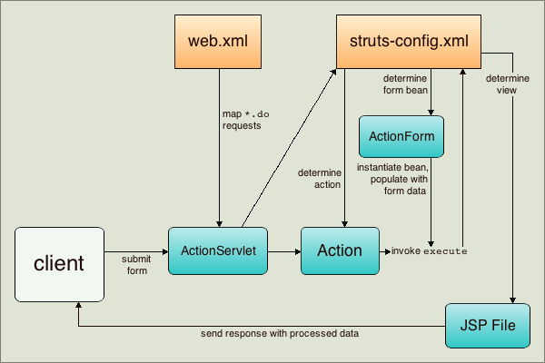

Slide 7
Hello World

Slide 8
Steps hello world
Step 1: Configure Front controller in web.xml, define url pattern
Step 2: Write the Action class
public class LogonAction extends Action {}
Step 3: Write the matching ActionForm
public class LogonForm extends ActionForm {}
Step 4: Create struts-config.xml map backing bean and back controller

Slide 9
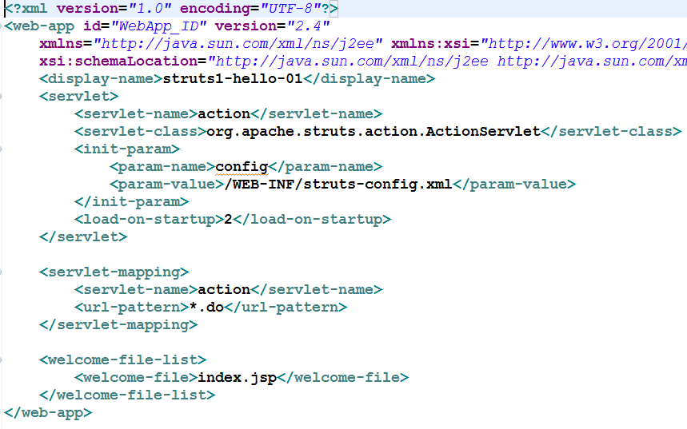
Step 1: Configure Front controller in web.xml, define url pattern
ActionServlet is provided by the framework.
The Servlet must be mapped in the web.xml file.
Must have configuration file mapped
Lastly, Map the *.do URI to the Action Servlet
We need to Configure front controller i.e. ActionServlet, we need to provide an param name config that take struts-config.xml

Slide 10
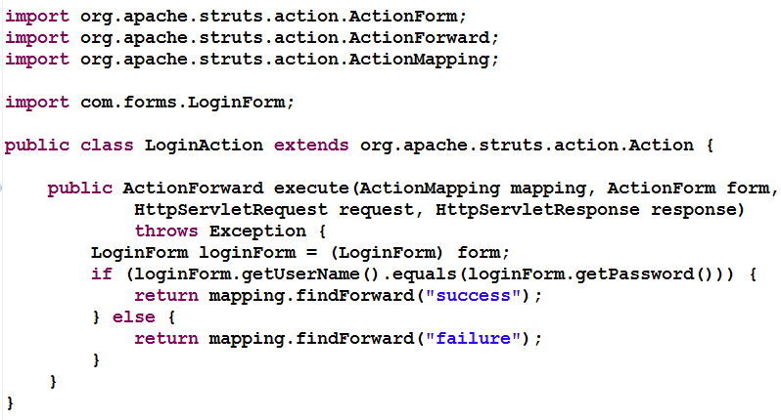
Step 2: Write the Action class
Step 2: Write the Action class
public class LogonAction extends Action {}
We need to write our action classes, they are back controllers

Slide 11
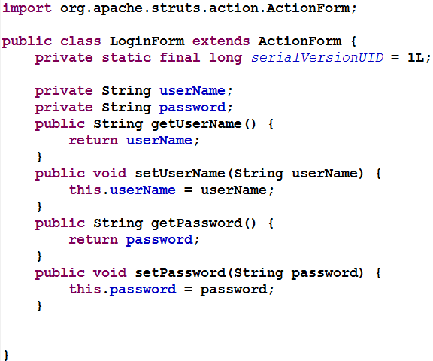
Step 3: Write the matching ActionForm
Step 3: Write the matching ActionForm
public class LogonForm extends ActionForm {}
ActionForm is backing form bean
It is used to collect data from the view and supply it to the back controller
Different object of Backing form bean is used for each new request, thread safe

Slide 12
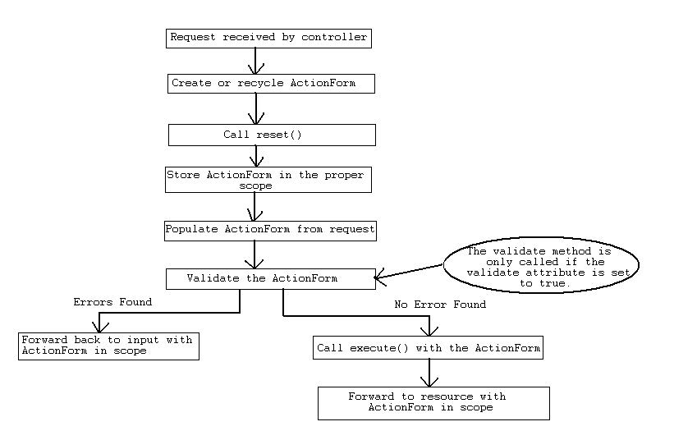
The lifecycle of an ActionForm

Slide 13
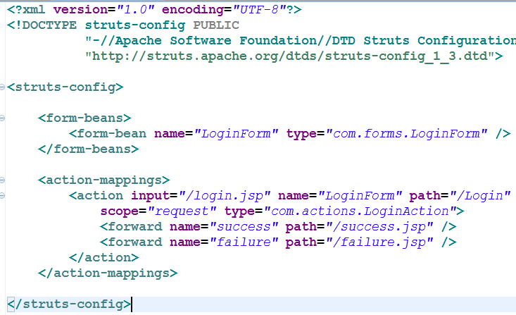
Step 4: Create struts-config.xml
Step 4: Create struts-config.xml
It map backing bean and back controller

Slide 14
Understanding Strut-config.xml
<action path="/logon“
type=“c com.actions LogonAction”
name="LogonForm"
.
<forward name="failure" path="/failure.jsp" />
<forward name="success" path="/success.jsp" />
</action>
For requests that hit URL=“/logon”
The frame work will invoke execute() on an instance of class com.actions.LogonAction
Store request parameters in form variable “LogonForm” which is defined in another location in the xml document.
If the logical name returned by perform() is “failure” go to page “/failure.jsp”
If the Logical name returned by perform() is “success” go to “/success.jsp”

Slide 15
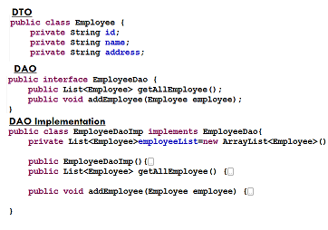
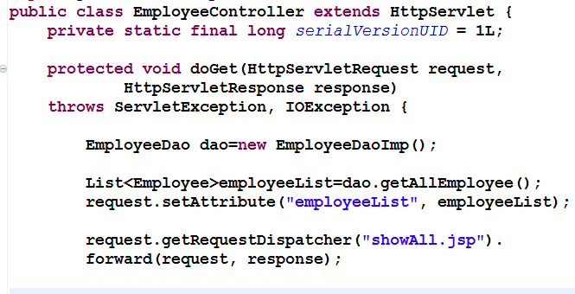

What one should know in JSP ?
what is the best way to present data in view layer?
Don't use scriptlet, perfer JSTL and custom tag
In case of struts use struts tags
Example: Employee Application, developed in Servlet/JSP session

Slide 16
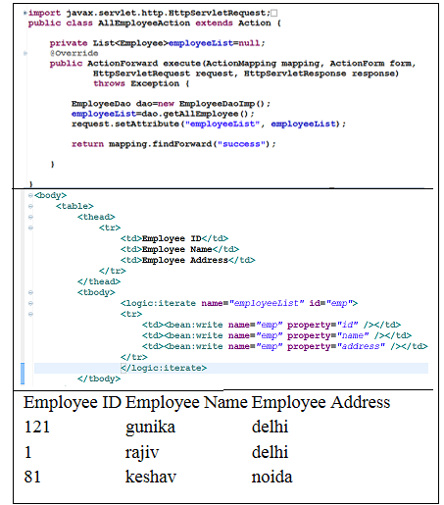

Using Struts logic and bean tags (Introduction)

Slide 17
Revisiting Hello world with validation and resource bundle

Slide 18
import org.apache.struts.action.*;
public class LogonAction extends Action {
public ActionForward execute(
ActionMapping mapping,
ActionForm form,
HttpServletRequest request,
HttpServletResponse response)
throws IOException, ServletException
{
LogonForm theForm = (LogonForm)form;
String forward="failure";
if(theForm.getUserName().equals("borcon"))
{
forward="success";
}
return mapping.findForward(forward);
}
}
Action class’s perform is invoked by Action Servlet

Slide 19
Action Form
import org.apache.struts.action.ActionForm;
public class LogonForm extends ActionForm {
private String userName;
private String password;
public String getUserName() {
return userName;
}
public void setUserName(String userName) {
this.userName = userName;
}
public void setPassword(String password) {
this.password = password;
}
public String getPassword() {
return password;
}
}
Action Form has properties which map to the HTML page.
Additionally the form can:
Reset
Validate

Slide 20
Strut Powered JSP
<head>
<title>Logon Form</title>
</head>
<body bgcolor="white">
<html:errors/>
<html:form action="logon" focus="userName">
User Name: <html:text property="userName" size="16" maxlength="16"/>
password: <html:password property="password" size="16" maxlength="16"
<html:submit property="submit" value="Submit"/>
<html:reset/>
</html:form>
</body>
</html:html>

Slide 21
Steps Hello World
Step 1: Build your JSP in HTML format
It’s back to editing code
Step 2: Convert to Struts format
Step 3: Write the matching ActionForm
public class LogonForm extends ActionForm {}
Step 4: Write the Action class
public class LogonAction extends Action {}
Step 5: Register the entries in struts-config.xml
<action path="/logon"
type="com.codementor.struts.LogonAction"
name="logonForm"
input="/Logon.jsp" >
<forward name="success" path="/Success.jsp" />
<forward name="failure" path="/Failure.jsp" />
</action>
Step 6: Configure web.xml with the ActionServlet

Slide 22
JSP Pages
Three Pages
Login Page
Success Page
Failure Page

Slide 23
Logon Page – HTML Version
<html>
<head>
<title>Login Form</title>
</head>
<body bgcolor="#ffffff">
<form action="logon.do">
User Name: <input type="text" name="userName" size="16" maxlength="16"/><br />
Password: <input type="text" name="password" size="16" maxlength="16"/><br />
<input type="submit" name="Submit" value="Submit">

Slide 24
Logon Page – Struts
<%@ taglib uri="/WEB-INF/struts-html.tld" prefix="html" %>
<html:html>
<head>
<title>Login Form</title>
</head>
<body bgcolor="#ffffff">
<html:form action="logon.do" focus="userName">
<br>
User Name: <html:text maxlength="16" property="userName" size="16"/><br />
Password: <html:text maxlength="16" property="password" size="16"/><br />
<html:submit value="Submit" property="Submit"/>
Added a cool feature

Slide 25
Success and Failure Pages
Success.jsp
<html>
<head>
<title>
Success
</title>
</head>
<body bgcolor="#ffffff">
<h1>
Successful Login
</h1>
</body>
</html>
Failure.jsp
<html>
<head>
<title>
Failure
</title>
</head>
<body bgcolor="#ffffff">
<h1>
Failed Login
</h1>
</body>
</html>

Slide 26
Create Form Bean Class
zpackage com.codementor;
import org.apache.struts.action.ActionForm;
public class LogonForm extends ActionForm {
private String password;
private String userName;
public String getPassword() {
return password;
}
public void setPassword(String password) {
this.password = password;
}
public String getUserName() {
return userName;
}
public void setUserName(String userName) {
this.userName = userName;
}
}

Slide 27
Form Bean Config
<struts-config>
<form-beans>
<form-bean name="logonForm"
type="com.codementor.LogonForm" />
</form-beans>
…
</struts-config>

Slide 28
Action Class
package com.codementor;
import org.apache.struts.action.*;
import javax.servlet.http.*;
public class LogonAction extends Action {
public ActionForward execute(ActionMapping mapping,
ActionForm form,
HttpServletRequest request,
HttpServletResponse response) {
LogonForm logonForm = (LogonForm) form;
String forward = "failure";
if(logonForm.getUserName().equals("mentor"))
{
forward = "success";
}
return mapping.findForward(forward);
}
}

Slide 29
Action Class Config
…
<action-mappings>
<action path="/logon"
type="com.codementor.LogonAction"
name="logonForm"
input="/Login.jsp"
scope="request" />
</action-mappings>
</struts-config>

Slide 30
Map The Forwards
…
<action-mappings>
<action path="/logon"
type="com.codementor.LogonAction"
name="logonForm"
input="/Login.jsp"
scope="request" >
<forward name="success" path="/Success.jsp" />
<forward name="failure" path="/Failure.jsp" />
</action>
</action-mappings>
</struts-config>

Slide 31
Struts in web.xml
<web-app>
<servlet>
<servlet-name>action</servlet-name>
<servlet-class>org.apache.struts.action.ActionServlet</servlet-class>
<init-param>
<param-name>config</param-name>
<param-value>/WEB-INF/struts-config.xml</param-value>
</init-param>
<init-param>
<param-name>debug</param-name>
<param-value>2</param-value>
</init-param>
<load-on-startup>2</load-on-startup>
</servlet>
<servlet-mapping>
<servlet-name>action</servlet-name>
<url-pattern>*.do</url-pattern>
</servlet-mapping>
Sets the logging level for struts
Loads ActionServlet on startup
** important if there is a JSP page
which could be referenced from the
Client **

Slide 32
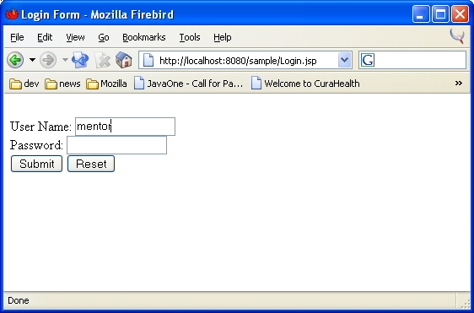
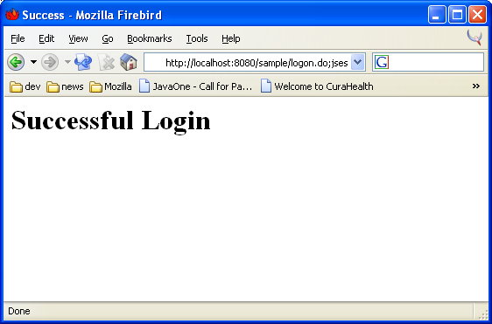
Run The WebApp

